Slide 1
Service Delivery: Global and Bangladesh Perspective
Yamin Tauseef Jahangir, MPH
Department of Public Health
School of Health & Life Sciences

Slide 2
Service Delivery
Type of service:
Personal and non-personal health services
Spectrum from promotion, prevention, treatment, palliation, rehabilitation
Levels of prevention: primary, secondary, tertiary etc.
Narrow/downstream/disease-specific to broad/upstream/non-disease-specific
Mode of delivery:
Periodic, acute/emergency, continuous
Community to facility-based
Attributes:
According to need – essential vs elective; high to low priority
Quality and safety
Coverage - available, accessible, affordable
Integrated and continuous vs fragmented and duplicative
From simple to complex

Slide 3
Service Delivery-contd.
Supply side perspectives:
Financing
Workforce
Information
Commodities
Infrastructure
Governance
Demand-side perspectives:
Accessibility
Affordability
Availability
Accommodating (responsiveness)
Answerable/accountable

Slide 4
Getting Services Right
Concepts of Allocative and Technical Efficiency
Allocative efficiency
Choosing the “right” services!
Highly efficacious – they work!
High health return
Not too expensive
Cost –effectiveness ratios
Technical efficiency
How to deliver the services that have been chosen
Organization and management day-to-day
Workforce – numbers, skill-mix, distribution
Supply Chains – procurement, stock-outs
Infrastructures – community clinics through hospitals
Information – facility and population-based
Governance – standards, norms, regulation

Slide 5
Major Obstacles in Service Delivery
Problems at the service delivery level.
Problems at the system or sector level.
Problems at policy-setting level.

Slide 6
NCD STRATEGIES
HIV STRATEGIES
National Plans
National Plans
Surveillance
Commonalities between health priority strategies and links to health systems building blocks
Surveillance
Healthy Lifestyles
Safe sex
Clinical prevention and treatment
Treatment
Continuing Care
Continuing Care
Strengthened health system platform to support delivery and equity
Stewardship
Health financing
Human resources
Health Information systems
Medicines, infrastructure and logistics
Service delivery
Health systems building blocks for prevention and control of Non-Communicable Diseases (NCDs) and HIV
Notes:
Given the range of actors and institutions encompassed by the health system, and the number of activities currently focused on health systems strengthening, challenges for the project include:
Clarifying how the project adds value to other WHO health system strategies in the Region (horizontal strategies)
Identifying where there is common ground with activities focused on other conditions such as HIV/AIDS (vertical strategies)
Defining the specific components of health system strengthening and development that will deliver improved NCD outcomes; ensuring these are feasible and relevant in different country contexts
For example, health insurance coverage of chronic conditions is a key issue for the project. However, in resource poor environments the focus may need to be limited to preventive care for common conditions which are amenable to effective treatment (with generic drugs and/or lifestyle modification) eg hypertension, early stage diabetes
Identifying the critical levers of change which will enable translation of evidence into action

Slide 7
People’s Health Problems
Problem concerning
Accessibility to essential health services
Quality of services
Inadequate of essential and accurate information on health
Unsafe environment

Slide 8
People’s Health Problems-contd.
Problem concerning: (1) Accessibility to essential health services, e.g.
long waiting time when seeking services from government hospitals which are always overcrowded
high cost of health care services charged by private hospitals or even some government hospitals which, in certain cases, may entail debt or cause severe economic problems to consumers
refusal on the part of hospitals to render services, in particular to emergency or accident cases if the ability to pay bills cannot be proved.

Slide 9
People’s Health Problems-contd.
Problem concerning: (2) Quality of services, e.g.
Inadequate information about illness
Inadequate information about treatments
Inadequate information and advice on essential self care
Lack of convenience in obtaining services
Low professional standard of doctors or other service personnel which might cause complication or even death
Delayed in receiving preventive care or screening, through readily available, until the illness becomes severe.

Slide 10
People’s Health Problems-contd.
Problem concerning: (3) Inadequate of essential and accurate information on health, e.g.
Information on toxic substances which are harmful to health
Information on basic self-care, the drugs
Etc.

Slide 11
People’s Health Problems-contd.
Problem concerning: (4) Unsafe environment, e.g.
Traffic accident
Pollution problem
Problems pertaining to unsafe workplaces

Slide 12
People’s Health System
Problem pertaining to health service systems, e.g.
Problems concerning changes in overall health situation: Changes in morbidity & mortality patterns, population structure
Rising cost of expenditure
Modern medical technologies utilisation
Government bureaucratic system

Slide 13
People’s Health System
Management
Organisation
Resources
Service
delivery
Health Needs
Health Results
Economic
support

Slide 14
Let’s Take A Break !

Slide 15
People’s Health System
Difference between personal care and population services
Health care system : principle & design
multi-level health care system
integrated health care system
roles and functions of different levels of health care system

Slide 16

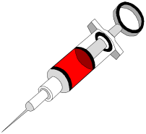


People’s Health System
Personal care v.s. Population based approach services v.s. Population services
personal care
personal care but
using population
based approach
population services

Slide 17
People’s Health System
Ultimate objectives of health care system
efficiency: Allocative and technical efficiency
quality: Technical and social dimension
equity: Horizontal and vertical equity
Trade-off between different objectives
trade-off between improvement of access to care of population by decentralisation of health facility and effective utilisation of decentralised health facility (economy of scale)
trade-off between attempt to response common health problems (with less severity) and attempt to response to serious health problems (but less frequency)
trade-off between efficiency and quality objectives

Slide 18
Current Health Situation
Efficiency problem
Quality problem
Equity problem
horizontal equity
vertical equity

Slide 19
Efficiency Problem
Rapid increasing of health expenditure with less health return
Allocative inefficiency
emphasize more on hospital based and specialised services than health promoting activities
Technical inefficiency
over medicalisation
uncontrolled investment of high cost medical equipment

Slide 20
Quality Problem
Unacceptable quality of care
less motivated health personnel
poor provider-patient relationship
take care of disease rather than the whole person
lack of quality assurance mechanism
uninformed services
patient can’t participate in the decision making process

Slide 21
Equity Problem
Horizontal equity
majority of the population are still uninsured
different quality of care according to different payment status of patients
negligence of people who are unaffordable
different health utilisation among various groups of population
Vertical equity
the poor pay more than the rich

Slide 22
Global Health Initiatives

Slide 23

Common challenges to scale up services for HIV, TB, malaria, and immunization
HIV/UA assessment
report
Global Plan to stop
TB
World Malaria
report
GAVI/Norad
report
Inadequate financing
HR crisis
Affordable commodities
Stigma, discrimination…
Accountability
Partnership alignment
Inadequate financing
Laboratory capacity
HR crisis
Quality drugs
Drug efficacy
Information system
Inadequate financing
HRH and Community services
M&E
HR crisis
Inadequate financing
Leadership and
management
Inter-agency
coordination

Slide 24
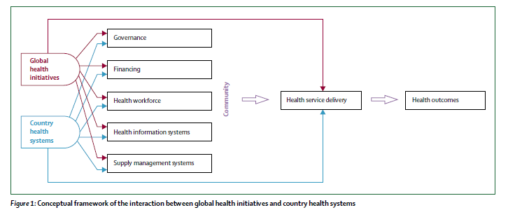
Conceptual Framework

Slide 25
Focused Areas for Health Reform
Service delivery
Governance
Financing
Health Workforce
Supply management
Information systems

Slide 26
The Way Forward
There is ample evidence of:
"strong synergies";
"serious shortfalls";
And "uncertainty"
Actions need to be developed towards:
Amplifying synergies
Stemming shortfalls
Understanding variation

Slide 27
Thank you

